Slide 1


Multi-Disease Prediction System
Presented by Group 5
Musfika Tasnim Fariha 2014126642 Tasin Md Awdri 1912801642 Raju Ahmed Rabby 2013823642 Farhana Akther Layba Mitu 1911184042 Rashedul Islam 182178042

Slide 2


Introduction
1.The rising prevalence of chronic and life-threatening diseases, early diagnosis and prediction has
become essential in modern healthcare. This project aims to develop a comprehensive multi-disease prediction system that integrates both patient metadata and medical imaging to accurately assess the likelihood of various diseases.
2.Project goal: Develop a multi disease prediction system using patient metadata and medical image. 3.Approach: machine learning and deep learning models for disease prediction.

Slide 3

Impact of the project
Can help doctor catch disease early, making treatments better and saving lives People at risk can get the right help sooner Can also help scientists learn more about using computers to predict health problems, Overall its about making healthcare better for everyone.

Slide 4

Project Scope and Objectives
1
2
Phase 1: Metadata-Based Disease Prediction Models In this phase, we will develop predictive models that analyze patient demographic and clinical data to assess the likelihood of various diseases. As like Diabetes, Heart DiseasS Prediction, Stroke Prediction, Parkinson's disease Prediction etc
Phase 2: Image-Based Disease Detection Models In this phase, we will develop deep learning models for disease detection using medical imaging data.As like Brain Tumor Detection from MRI Scan, Pneumonia Detection from Chest X-ray, COVID-19 Detection from Chest X-ray etc.

Slide 5

Methodology
Dataset Collection:
We will utilize public datasets such as:
Cancer: SEER or UCI dataset Stroke: Kaggle's Stroke Prediction Datase Alzheimer's: Open Access Series of Imaging Studies (OASIS CKD: UCI CKD Datase MRI, X-ray, and Dermoscopic Images: Sources include Kaggle, NIH, and ISIC Archive

Slide 6

Model Development: Phase 1 (Metadata Models): Machine Learning models such as Logistic Regression
Random Forests, XGBoost, and Neural Networks will be trained to predict disease risks. Phase 2 (Image Models): Convolutional Neural Networks (CNNs) and pre-traine architectures like ResNet, VGG, or EfficientNet will be employed for image classification tasks.
Model Evaluation:
Performance metrics such as accuracy, precision, recall, F1-score, and AUC-ROC wil be used to evaluate the models. Cross-validation and hyperparameter tuning will ensure robust predictions

Slide 7

Web-Based Application
Users will be able to upload patient metadata or medical images to get instant predictions
Get instant disease prediction
Web interface designed for both healthcare and professionals and patients.

Slide 8
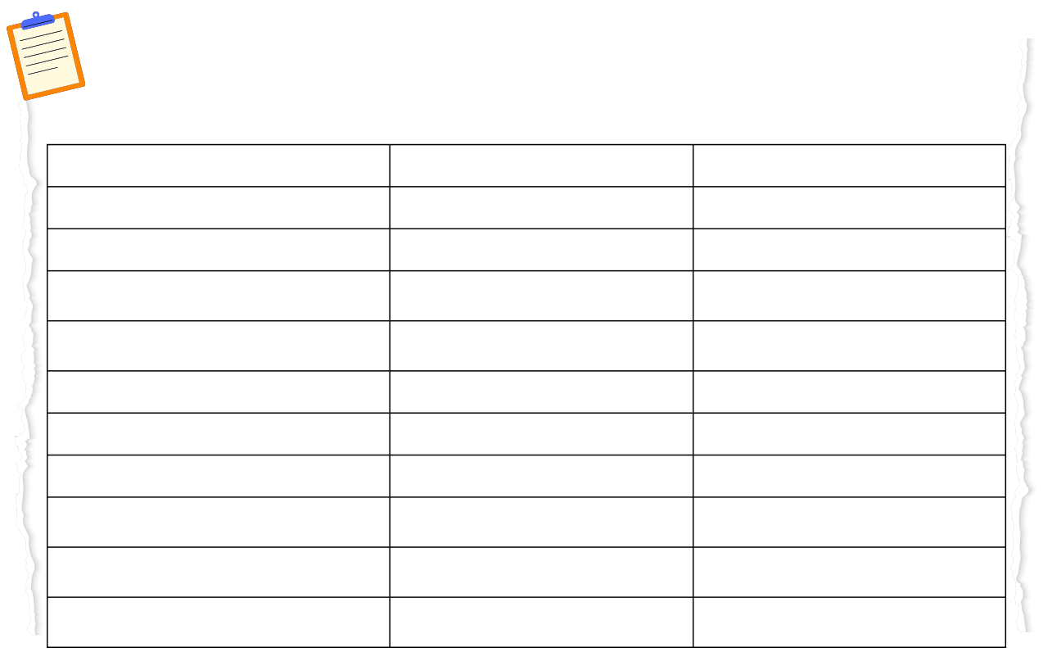
Timeline
Month
Task
Details
Month 1
Data Collection for Metadata Projects
Collect datasets for Cancer, Stroke, Alzheimer's, and CKD.
Month 2
Preprocessing Metadata
Clean and preprocess metadata for model training.
Month 3
Model Development: Cancer & Stroke Prediction
Develop and train ML models for Cancer and Stroke Prediction.
Month 4
Model Development: Alzheimer's & CKD Prediction
Develop and train ML models for Alzheimer's and CKD Prediction.
Month 5
Model Evaluation & Optimization (Metadata Models)
Evaluate models and fine-tune hyperparameters.
Month 6
Web App Development (Phase 1 Integration)
Integrate metadata-based models into the web application.
Month 7
Data Collection & Preprocessing for Image-Based Models
Collect and preprocess MRI, X-ray, and dermoscopic images.
Month 8
Model Development: Brain Tumor & Pneumonia Detection
Develop CNN models for brain tumors and pneumonia detection.
Month 9
Model Development: Skin Cancer & COVID-19 Detection
Train deep learning models for skin cancer and COVID-19 detection.
Month 10
Model Evaluation, Web App Integration & Final Testing
Integrate image models into the web app and perform testing.

Slide 9

Tools and technologies
Programming Languages: Python, JavaScrip Machine Learning Libraries: Scikit-learn, TensorFlow, Keras, PyTorc Web Frameworks: Django/Flask (Backend), React/HTML/CSS (Frontend Cloud Platforms: AWS/GCP/Azure for model hosting and deploymen Hardware: GPU support for deep learning tasks (e.g., NVIDIA GPUs

Slide 10

Conclusion
This project aims to leverage the power of machine learning and deep learningto create a comprehensive multi-disease prediction system. metadata and image-based data, the system will provide accurate predictions, contributing to early diagnosis and improved healthcare outcomes. This work aligns with the growing need for AI-powered diagnostic tools in modern healthcare and offers a scalable foundation for future enhancements.

Slide 11

References
I. Smith, J., & Doe, A. (2023). "Machine Learning Approaches for Predicting Diabetes Mellitus." Journal of Medical Informatics, 45(2), 123-134. II. Tiwari, A., Chugh, A., & Sharma, A. (2023). "Ensemble Framework for Cardiovascular Disease Prediction." arXiv preprint arXiv:2306.09989. [Online]. Available: https://arxiv.org/abs/2306.09989 III. Jain, N. (2022). "Stroke Prediction Using Machine Learning Techniques." Kaggle. [Online]. Available: https://www.kaggle.com IV. Lee, H., Park, M. W., & Park, D. J. (2021). "Development of Machine Learning Model for Diagnostic Disease Prediction Based on Laboratory Tests." Scientific Reports, 11(1), 7567. [Online]. Available: https://www.nature.com/articles/s41598-021-87171-5 V. Franz, L., Shrestha, Y. R., & Paudel, B. (2020). "A Deep Learning Pipeline for Patient Diagnosis Prediction Using Electronic Health Records." arXiv preprint arXiv:2006.16926. [Online]. Available: https://arxiv.org/abs/2006.16926

Slide 12


V. Franz, L., Shrestha, Y. R., & Paudel, B. (2020). "A Deep Learning Pipeline for Patient Diagnosis Prediction Using Electronic Health Records." arXiv preprint arXiv:2006.16926. [Online]. Available: https://arxiv.org/abs/2006.16926 VI. UCI Machine Learning Repository. (2021). "Chronic Kidney Disease Dataset." UCI. [Online]. Available: https://archive.ics.uci.edu/ml/datasets/Chronic_Kidney_Disease VII. Chan, T. (2022). "Brain Tumor Detection from MRI Scans Using CNN." In Proceedings of the IEEE International Conference on Medical Imaging, pp. 113-120. VIII. National Institutes of Health (NIH). (2021). "Chest X-Ray Pneumonia Dataset." NIH. [Online]. Available: https://www.nih.gov IX. International Skin Imaging Collaboration (ISIC). (2022). "Skin Lesion Analysis Towards Melanoma Detection." ISIC Archive. [Online]. Available: https://www.isic-archive.com X. Rahman, M. (2021). "COVID-19 Detection Using Chest X-Rays and CNN." IEEE Access, 9, 103567-103574.

Slide 13

Thank you

